Slide 1

ASSIGNMENT 6
Channel Capacity Optimization:
Water-filling Algorithm

Slide 2


Problem Statement
In a frequency-selective fading channel, signal attenuation varies across different subchannels.
The Goal:
•
Develop a MATLAB simulation to maximize the total capacity of a wireless channel.
•
Implement the Water-filling Algorithm for optimal power allocation.
Optimal Allocation
Maximize Rate vs Power Constraint
•
Distribute a fixed power budget ($P_t$) across $N$ subchannels based on their channel gains ($|h|^2$).

Slide 3
Objectives
1. Implementation
2. Comparison
•
Simulate a Rayleigh fading channel with multiple subchannels.
•
Compare Water-filling (Optimal) vs Uniform Power Allocation (Equal power to all).
•
Compute the "Water Level" (mu) derived from Lagrange multipliers.
•
Analyze the Spectral Efficiency (bits/s/Hz).

Slide 4
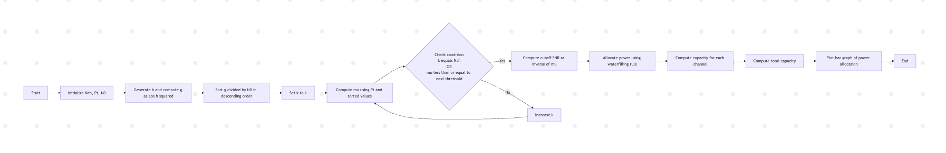




Data Flow Diagram (DFD)
($N_{ch}, P_t, N_0$)
(Calc Gains g, Sort Descending)
(Find mu, Allocate P_i)
(Capacity, Plots)

Slide 5
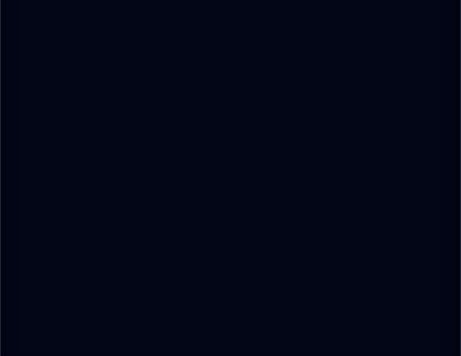
Pseudocode: Initialization
% 3. Sort Gains (Descending)
% Critical for finding cutoff threshold
Step 1: Channel Setup
% 1. Initialize Parameters
Nch = 6;
Pt = 5;
N0 = 1;
% 2. Generate Channel Gains
h = (randn(1, Nch) + 1j*randn(1, Nch)) / sqrt(2);
g = abs(h).^2;
% 3. Sort Gains (Descending)
% Critical for finding cutoff threshold
[g_sorted, idx] = sort(g/N0, 'descend');
Initialize system parameters and generate random Rayleigh fading coefficients. Compute channel-to-noise ratios (CNR).
•
Generate complex Gaussian h.
•
Compute power gain g = |h|^2.
•
Sort gains to simplify the water-filling logic (Strongest first).

Slide 6
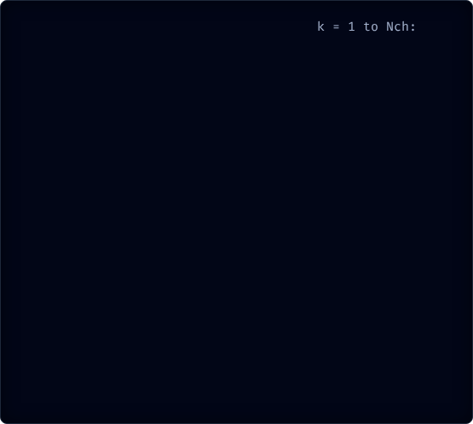
Pseudocode: The Waterfilling Algorithm
a
IF
% Found cutoff k
END IF
END FOR
% 5. Allocate Power
FOR
END FOR
% 6. Calculate Total Capacity
% 4. Iterative Water Level Finding
FOR k = 1 to Nch:
% Calculate potential water level mu
mu = (Pt + sum(1 ./ g_sorted(1:k))) / k;
% Check if next channel is too weak
IF (k < Nch) AND (mu <= 1/g_sorted(k+1)):
BREAK loop; % Found cutoff k
END IF
END FOR
% 5. Allocate Power
P_opt = zeros(1, Nch);
FOR i = 1 to k:
P_opt(idx(i)) = mu - 1/g_sorted(i);
END FOR
% 6. Calculate Total Capacity
C = sum(log2(1 + P_opt .* g / N0));

Slide 7
Start
Set number of channels Nch
Set total power Pt and noise N0
Generate Rayleigh fading channel h
Compute power gains g = |h|²
--- Uniform Allocation ---
Divide total power equally across channels
Compute uniform capacity
--- Water-Filling Allocation ---
Sort channel gains in descending order
Find water level μ using iterative condition
Compute optimal power P_opt = μ − 1/g for active channels
Compute water-filling capacity
Display cutoff SNR, optimal power, capacities
Plot water-filling vs uniform power levels
Plot water level line
Plot bar chart comparing capacities
End
Comparison between Uniformly Distributed and Waterfilling Pseudocode:

Slide 8
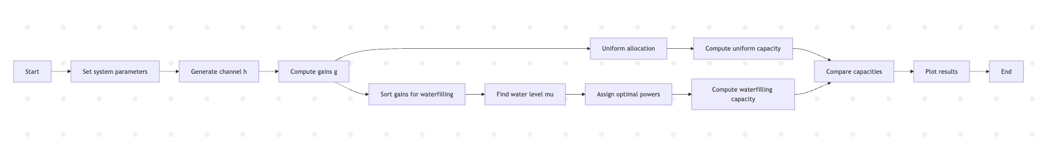
Process Workflow

Slide 9
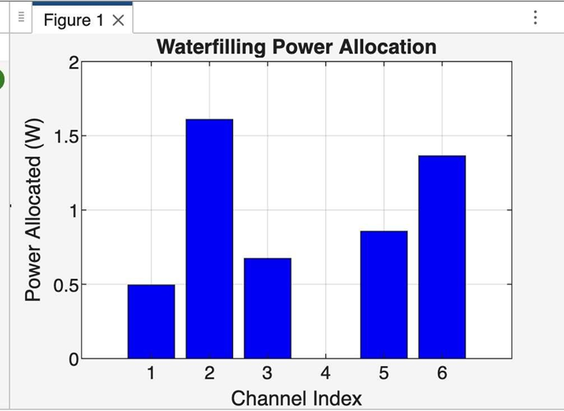
Simulation Results
1. Power Allocation
As seen in the simulation output:
•
Strong channels received significantly more power (e.g., 1.6W, 1.36W).
•
Weak channels (Index 3 and 4) received 0 Watts because their inverse gain was above the water level.
•
Cutoff SNR (1/\mu): Calculated as ~0.4612.

Slide 10
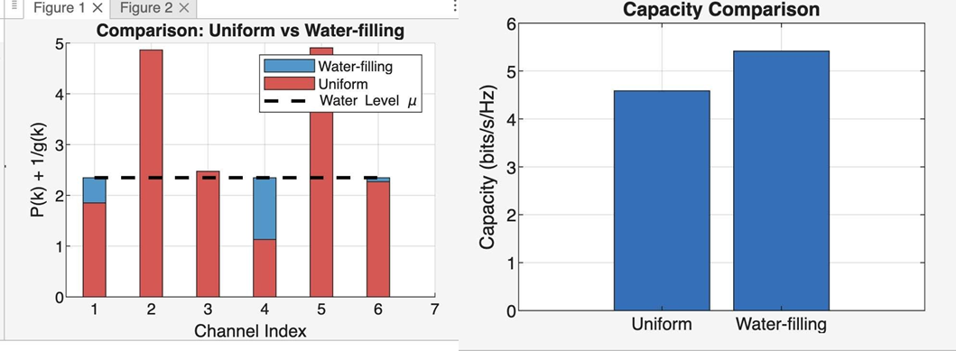

Slide 11
Comparison & Conclusion
Capacity Comparison
Method | Capacity (bits/s/Hz)
Water-filling | 5.4176
Uniform Allocation | 4.5859
Conclusion
•
The Water-filling algorithm successfully maximizes theoretical capacity.
•
By sacrificing weak channels, we gain significant throughput in strong channels.
•
It outperforms uniform allocation by approx 18% in this scenario.

Slide 12

Future Scope
This algorithm is foundational for modern systems. Future enhancements include:
•
MIMO Systems: Applying water-filling to spatial eigenmodes (Singular Value Decomposition).
•
OFDM: Used in 4G/5G to allocate power across thousands of subcarriers.
•
Real-time CSI: Adapting to fast-changing Channel State Information in high-mobility scenarios.

